Slide 1

MINI PROJECT 1-B
(Topic selection)
A.Y-2022-2023
Computer Science and Engineering
( AI & ML )

Slide 2
Our Topics :
1. THE PREDICTOR
2.PERSONAL VOICE ASSISTANT
3.NPC : AI VIRTUAL ROBOT

Slide 3

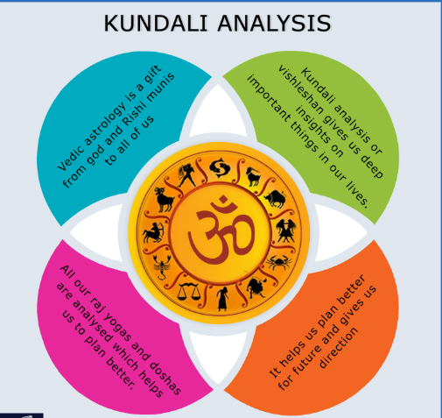
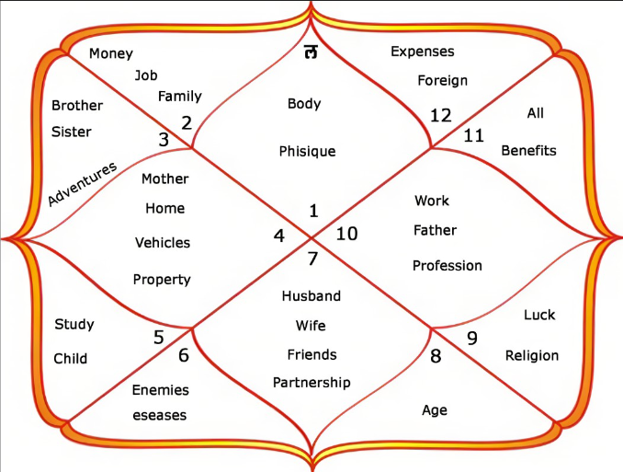
TOPIC 1
THE PREDICTOR
We approach with a unique type of project the predictor . This project will keep it base in vedic astrological calculations and is useful to make Future predictions. our project will help user to read birthchart and inturn help them to know more about their Past,Present and Future, As there are rarely such programs on the internet. This will be one of its kind . As we know reading a birth chart needs a jyotish or an astrologer , They might have different perspective which differ possibly by multiple calculation error and to avoid this our program is here to make an accurate predictons of one's Life .

Slide 4
TOPIC 1
Features:
Analyzing Birth Chart for Possible Events
User can find Education Choices
User can get suggestions for his personal problems
User can know about his True Self
User can know about their Soul mate
A Generated Prediction Report on your Job ,Income and Opportunities.
Provides you with predictions of your Family,Friends and Martial Conditions

Slide 5
TOPIC 1
Software Used: Python
Database Connectivity : MYSQL
Mysql is Structured Query Language used widely to store Data
Alternate Systems
Software Used: VB applications
Database Connectivity : Mysql / Microsoft Access
Microsoft Access is a DBMS from microsoft itself
That combines relational Database engine with GUI

Slide 6
TOPIC 2
PERSONAL VOICE ASSISTANT
In this modern era of Digitalization ,
This Project deals with Researching and creating by knowing how a voice assistant work
And developing a similiar model like google assistant and alexa.
It is a Software agent that perform tasks or services assigned to it by the user through various
Commands
A voice assistant is a digital assistant that uses voice recognition ,language processing algorithm
And voice synthesis to listen to specific voice commands and return to relevant information

Slide 7
TOPIC 2
Features:
The Overall System design consists of following phases-
Data collection in the form of speech
Voice analysis and conversiont to text
Data Storage and Processing
Generating Speech from the processed text output

Slide 8
TOPIC 2
Software Used: Python
Database Connectivity : MYSQL
Mysql is Structured Query Language used widely to store Data

Slide 9
TOPIC 3
NPC : AI VIRTUAL ROBOT
Virtual Robot are Simulated Robots used to generate programming for robots.
Simulation is an effective means for understanding how physical concepts like force and
Motion come to play in real life.

Slide 10
TOPIC 3
Features:
1.AI Algorithm to Simulate Accident
2.Virtual Simulation of Human Behaviour
3.Decisions making algorithms which will simulate human understanding of Circumtances

Slide 11
TOPIC 3
Software Used : Roblox Studio
Language: Lua
Database: The Database Service we will be using is ReplicatedStorage

Slide 12
Thank You

